Slide 1
Data visualizations for usual intakes
PHAC Health Infobase
February 13, 2020

Slide 2
Outline:
What is the Public Health Infobase?
Review tools being developed to visualize usual intake data
Request for help!
  Describing usual intake distribution curves
  Information to support interpretation
Ideas for future data visualizations

Slide 3
What is the Public Health Infobase ?
A series of Internet based tools to help visualize, analyze, interpret and disseminate health indicator data for chronic disease, injury and child/maternal health
Surveillance and Epidemiology Division, Centre for Surveillance and Applied Research, Health Promotion and Chronic Disease Prevention Branch, PHAC
https://health-infobase.canada.ca/

Slide 4
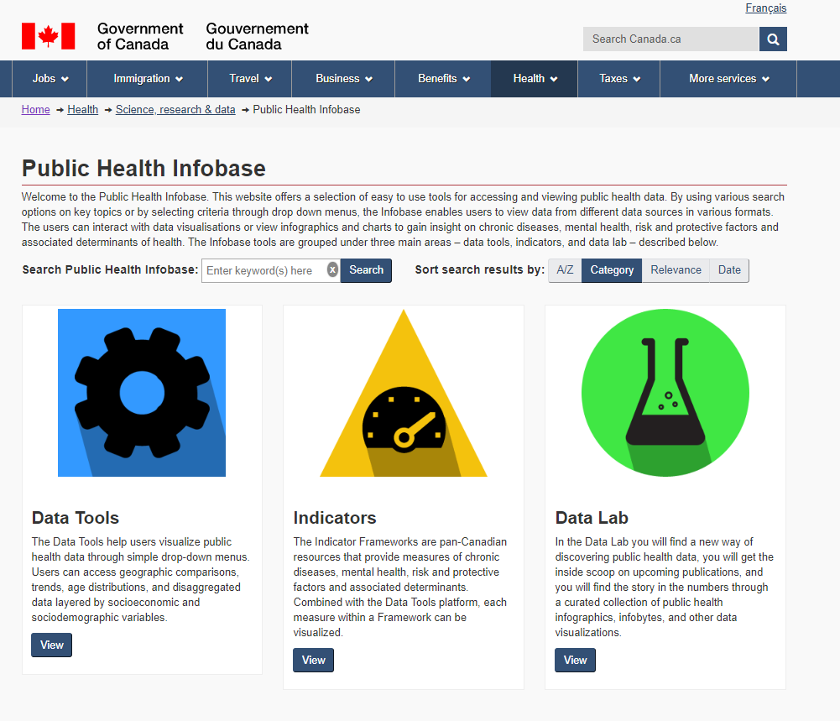

Slide 5


Slide 6
Tools being developed to visualize usual intake data
Usual intake distribution curves
Geographic comparison for inadequate/excessive intakes

Slide 7
Help! Describing usual intake distribution curves in words
Treasury Board Standard on Web Accessibility requires a text alternative for non-text content (e.g. pictures, charts, audio files, etc.) for those who cannot view the non-text content.
Requirement typically met by including a table with the data as presented in the graph.
Data as displayed in the usual intake distribution curves would be difficult to interpret in table form. Plan to display the non-transformed usual intake data in a table.
We are required to include a text alternative for the curves.

Slide 8
Text description for usual intake distribution curves
Need to find a balance between being descriptive enough and flexible enough that it can work for all nutrients, DRI age-sex groups.
Example of how Forest has programmed the titles to be displayed:
  [Nutrient] usual intake distribution, [sex], [age], Canada, 2015
  Example: Sodium usual intake distribution curve, males, 19-30 years, Canada, 2015
Idea suggested by partners at Infobase:
  The [Nutrient] usual intake distribution for Canadian [sex] aged [age], peaks at a [Nutrient] usual intake level of [insert value] and relative probability density of [insert value], which is [higher/lower/equal to] the [DRI type] of [insert value] and [higher/lower/equal to] the [DRI type] of [insert value].

Slide 9
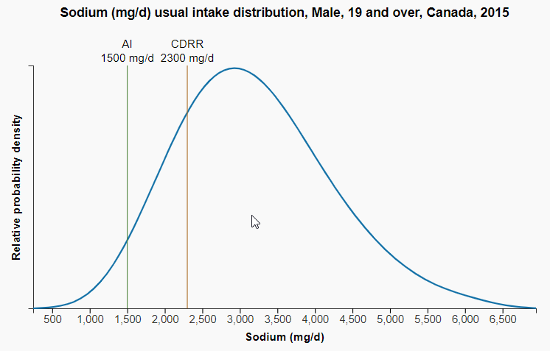
Example
  The sodium usual intake distribution for Canadian males aged 19 and over, peaks at a sodium usual intake level of ~3100 mg and relative probability density of xxx, which is higher than the Adequate Intake of 1500 mg and the Chronic Disease Risk Reduction intake level of 2300 mg.

Slide 10
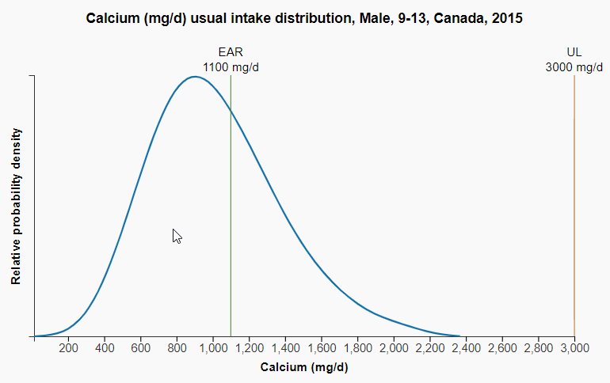
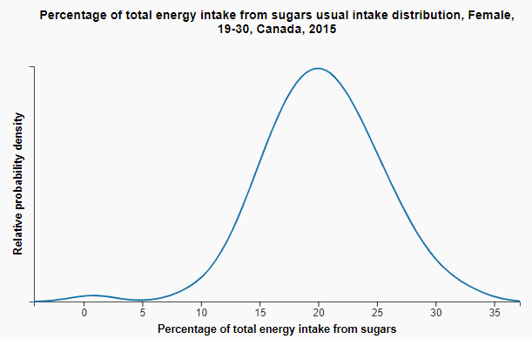
What are the most important elements to describe?

Slide 11
What to include in footnotes?
Data source, abbreviation definitions, STC notes (E, F, <3), link to reference guide & methodology guide
Relative probability density estimates were generated from the percentiles of usual intake data set using a Gaussian Kernel density estimation method.
Statement about reliability of the tails?

Slide 12
Ideas for future visualizations
Adding total usual intake distribution curve
Top food sources of nutrients of public health concern

Slide 13
  We can put a lot of data on the web:
  Who is the audience / who do you want to reach ?
  What information do you want them to reach ?

